Slide 1

CSC346-Computer Organization and assembly language Lab Lecture Semester-# Fall 2020
Prepared by:
Huma Chaudhry
M.Phil Computer Science

Slide 2
Software Name
software name: Emu8086
License Name: root
Registration Key: 27R3VDEFYFX4N0VC3FRTQZX

Slide 3
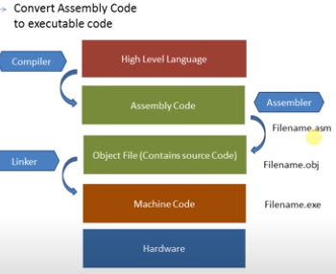

Slide 4
Data Registers:
They are temporary memory storage units
They can be catagorized into
32 bit catagory
16 bit catagory
8 bit catagory

Slide 5
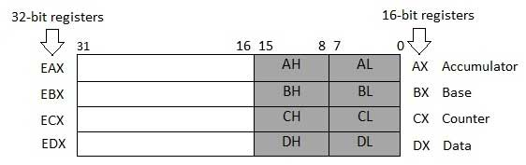
DATA Registers Types
EAX EBX ECX EDX are 32-bit data registers
Lower halves of the 32-bit registers can be used as 16-bit data registers also knows as general purpose registers: AX, BX, CX and DX.
Lower and higher halves of the above-mentioned four 16-bit registers can be used as eight 8-bit data registers:
AH, AL, BH, BL, CH, CL, DH, and DL.

Slide 6
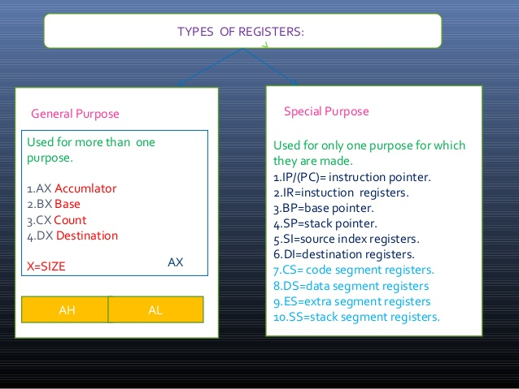

Slide 7
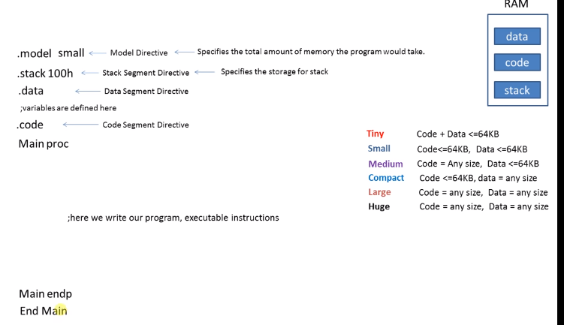
Assembly language syntax

Slide 8
General Purpose Registers
AX is the Accumulator Register:
it is used in input/output and arithmetic operations ADD,SUB,MUL,DIV in multiplication operation, the output is always stored in the AX register.
BX is known as the base register:
as it is used as a temporal memory storage and as an assistance to AX for arithmetic register.
CX is known as the counter register:
controls the loop as it stores the loop count in iterative operations.
DX is known as the data register:
It is also used in input/output operations. It is used to print the output on the console screen using data operations and divide operations involving large values.

Slide 9
For comment in Assembly Code
The comments in the code are written by using a ";" .

Slide 10
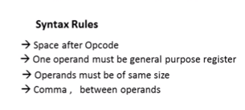
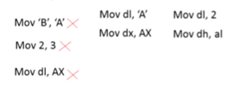
Syntax Rules

Slide 11
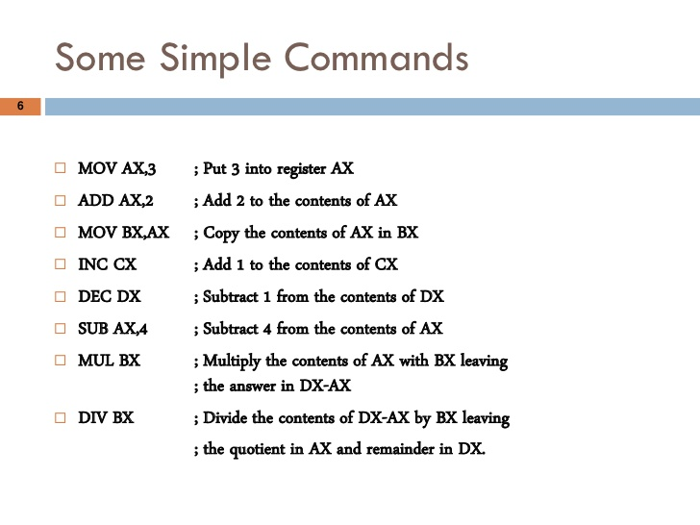

Slide 12
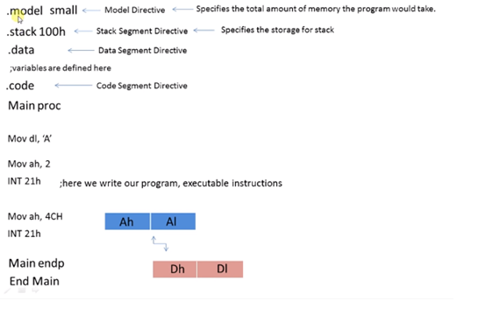
Program to print a single character

Slide 13
Assignment
Write a program that display the following output in a new line.e.g
12345

Slide 14
Q & A

